Slide 1

Testing Java Card Applets using concolic execution
Marouan SAMI - TAMIS Team
Notes:
Hello and welcome everyone, I’m Marouan SAMI a computer science student, I’m giving this presentation to sum up my work during those 2 months as a TAMIS member.

Slide 2
Introduction
Java Card
Path exploration & JPF
Concolic execution & JDart
Integrating Java Card Framework
Java Card under test
Conclusion
Notes:
Today we’ll talk about Testing Java card applets using concolic execution technique.
We’ll start with a brief introduction to smart card and java card (probably most of you have an idea what Java cards are ;) )
Then we’ll discover Java Path Finder a path exploration tool, Concolic execution, some extension of the JPF tool.
well then things will get a little bit more complicated when we’ll integrate the java card framework into this tool
Finally we’ll get to the point of testing Java card applets.
So let's start !

Slide 3
What are Java Cards ?
Notes:
Before we can talk about Java Card we need to know what smart cards are, Well they are tiny computers that we carry with us everyday !
your SIM Card, your Bank card, and even your social security card
Those integrated circuit cards are have a CPU architecture of 8 or even 16 bits, some kilobytes of memory and IO support to communicate with external devices, actually it can ensure transactions and encrypted data exchanges.

Slide 4
Java Card (½)
Java language, however..
No garbage collection
No Strings, no floats, no multidimensional arrays
No threads
At least we have Exceptions
Notes:
Java card is a system build upon Smart cards to make possible programming java language of them.
Well yeah it is java language but..

Slide 5
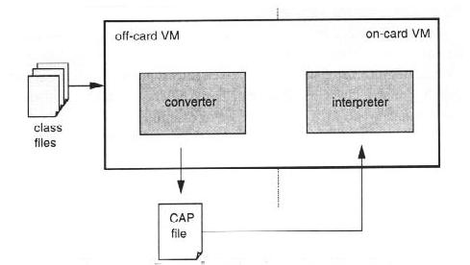
Java Card : Virtual Machine(2/2)
Notes:
The Java Card virtual machine is a split of two parts: off-card part and on-card part.
Many tasks such as class loading, bytecode verification, resolution and linking, are processed by the off-card virtual machine, where resources are not as limited as in the card.
The on-card VM provides the runtime environment

Slide 6
Path exploration & JPF
Notes:
Java Path Finder is a state model checker for Java programs. JPF was created by the NASA to test its rovers. Btw curiosity was also tested by this amazing tool.
So mainly JPF is a virtual machine that runs inside the Java virtual machine to be able to analyse bytecode, it executes the software under test as many times as needed to be able to explore every path that it contains.
While exploring paths, JPF checks for property violation like unhandled exceptions, deadlocks… Then it reports the trace that leads to those violations.

Slide 7
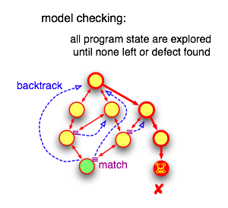
Model Checking doesn’t depend on guesses
Notes:
Model checking doesn’t depend on guesses, if there is a property violation then JPF will find it since it is a method that exhaustively explores all possible behaviours
and that’s why it’s very effective.
but when trying to explore and execute every path in the program, usually the number of those paths grows out of hand which is known as state explosion problem.
To solve this issue, JPF do state matching so it compares the current state to a previously seen states if it matches then we skip this path exploration and backtrack to a previous position that has unexplored paths.

Slide 8
Concolic execution & JDart
Notes:
Java Path finder is not a black box tool, one of the greatest features that it offers is its extensiveness !
Anyone can create his own extension upon JPF, and actually there is a lot of useful extensions !
One of them is JDart a concolic execution engine.

Slide 9
Concolic execution
It starts with concrete input value
Creating logic formulae from a set of conditional statements
Negating a sub-formula to get a new vector of concrete inputs
Re-execute the program with the new concrete values
Symbolic & concrete
execution
Notes:
Concolic execution is a technique that uses both symbolic and concrete execution to solve a constraint path it allows to maximize code coverage.
A concolic execution starts with concrete input value, as the program execution proceeds, symbolic path constraints are formed.
Those symbolic constraints are in fact logic formulae composed of set of conditional statements that were collected along the way.
Then it negates a sub-formula of the path constraint so we can build a new vector of concrete input values
we use this vector for another execution that will result in new path definition.
We can repeate those procedures until all possible paths are discovered.

Slide 10
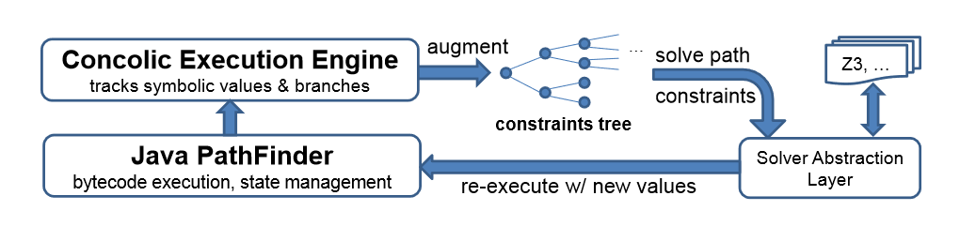
JDart (½)
Notes:
JDart is the extension that brings concolic execution to JPF, it tracks symbolic values and branches and builds the constraints tree.
To resolve symbolic expressions it uses by default Microsoft Z3 constaint solver but it also provides a solver abstraction layer in order to allow the integration of other constraint solvers.

Slide 11
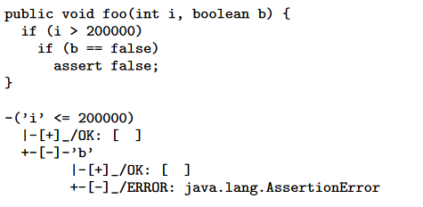
JDart (2/2)
Notes:
Let’s see a small example of how all of this works

Slide 12
Integrating Java card framework
Notes:
Now we reached the tricky part!
As we saw, JPF creates its own virtual machine to be able to analyse Java bytecode so to run java card applets we should integrate its API.

Slide 13
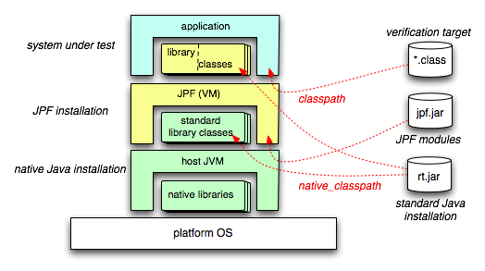
Integrating Java card framework
Notes:
The global architecture is quite complex, it’s not always simple to know what code get processed at which level.
To make it worse, most of the standard libraries get processed by both VMs in different instantiations.
Here we can see the different layers and different calls.
to actually make tests using concolic execution on java card applets it is necessary to do some modifications on the Java Card API due to native methods that it contains.
So basically we need to integrate the Java card framework inside this architecture and make sure it gets processed correctly because we can’t run the JCVM inside a computer so the idea here is to make JPF tests our java card applets as they are normal java programs
but we need to make it look like the real Java card runtime environment.

Slide 14
Java Card under test
Notes:
We’ll start with a small demo of Jdart running on java cards.
Applying JPF to a program gives a clear view of its structure, it also gives what are the exact conditions to be satisfied that causes exception raise and unexpected results.
But what if we want to know if the applet follows the ISO 7816 specification and no forbidden transition from a state to another is violated?

Slide 15
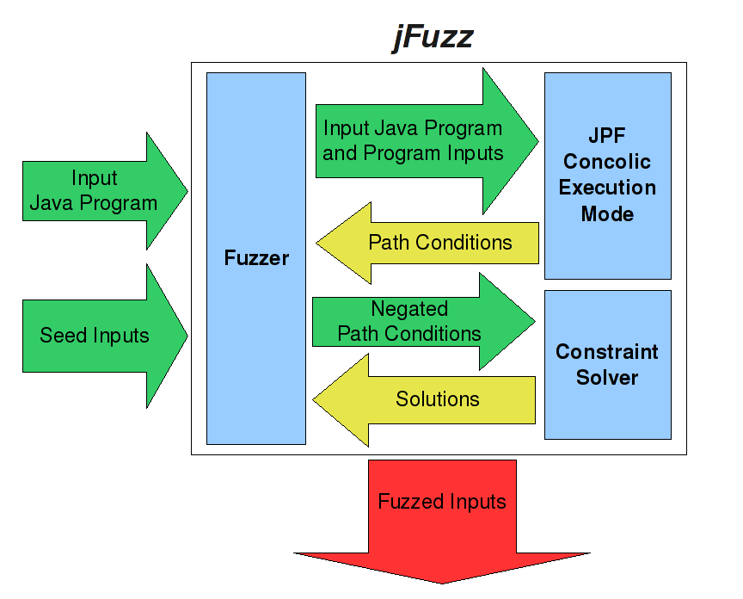
Java Card under test
Fuzzing
Notes:
One way to resolve this is to create a concolic fuzzer over JPF. This fuzzer would discover every path and every branch using the concrete values generated by the concolic execution.
JPF has an extension that does a concolic fuzzing called JFuzz, unfortunately it is no longer maintained and there is no good support for this extension. But we still can create our own Concolic fuzzer based on this one !

Slide 16
Java card under test: Creating automata
Notes:
Another alternative is to generate an automata of the SUT that describes all its states and transitions.
Since JPF is a model checker realising this idea is relatively easy. This automata generated will be compared to the automata given by the ISO 7816 specification. Considering that the vendor may add his own specific states and transitions in his implementation of the specification. It is still possible to determine what is safe and what may cause problems

Slide 17
Conclusion
Notes:
JPF is a great tool for testing java programs, thanks to its extensiveness however there are no extension designed for Java Card.
We believe that contributing in this field will make a good contribution to the community.

Slide 18
Thank you.

